Slide 1

ELECTRICAL TEAM WEEK 4 PROGRESS REPORT
Team members
Eunice Orenge
Laban Mwangi
Stephen Kinuthia
Victor Maina

Slide 2
OBJECTIVES OF PAST WEEK
1. Continue troubleshooting the motor controller
2. Designing power ports

Slide 3
1. TROUBLESHOOTING PROGRESS
So far , our troubleshooting has been to no avail. The motor controller keeps giving three recurring errors which are:
Accelerator fault alarm
Encoder fault alarm
Under voltage alarm
However , we did manage to get in contact with the manufacturers and they gave us a more detailed manual and possible issues that might be causing the errors.

Slide 4
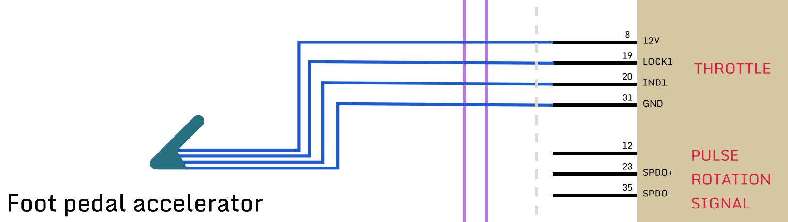
1a. Accelerator fault alarm
The working principle of the throttle is as follows:
The controller has 4 pins for throttle control ie. a 12V output pin, a ground terminal, a 0-5V signal input pin(IND1) and a switch pin (LOCK PIN). The throttle is supplied power using the 12V supply output and grounded with the controller’s ground.The lock pin is set to high by connecting it to the 12V supply. By varying the throttle, an input is sent to the controller, 0V for no motor action and 5V for high motor speed.

Slide 5
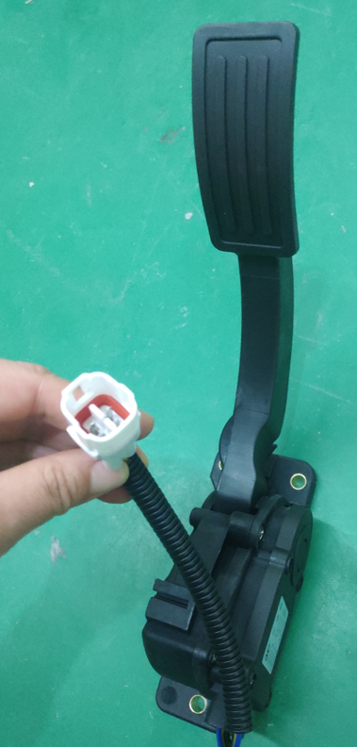
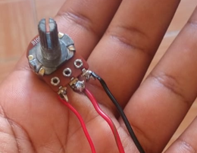
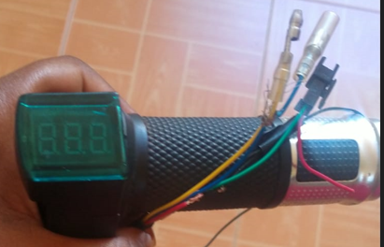
Possible error causes:
Incompatible foot pedal - we sent the manufaturer pictures of the throttle we were using and they said that could have been our source of error. They also gave us a recommendation for a compatible one as shown below (far right):
Our troubleshooting involved switching between two throttles and varying the supply to them in an attempt to make the motor run once again.

Slide 6
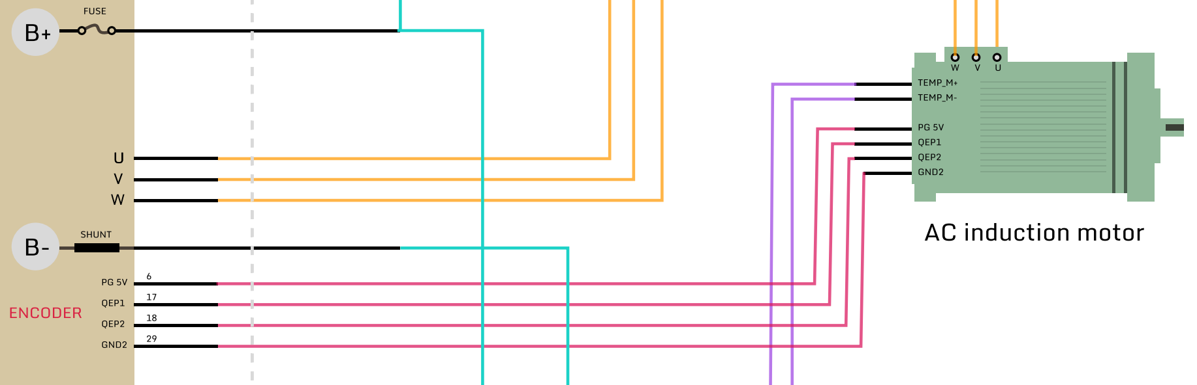
1b. Encoder fault alarm
The working principle of the encoder is as follows:
The motor encoder is responsible for converting mechanical rotation to electrical signals.These signals are responsible for speed & torque control and braking. The controller supplies 5V output with a ground to the motor’s encoder adapter and the motor sends back signals through the other 2 pins.

Slide 7
Possible error causes:
Under-voltage supply by the controller- the encoder’s 5V supply outputs 2-3V which on powering it with a 5V external source clears the error.
We strongly believe the encoder fault alarm goes hand in hand with the undervoltage alarm.
In addition , at times we manage to clear all errors but upon trying to start the motor, the motor’s shaft does not rotate nor does the controller provide AC power to it.

Slide 8
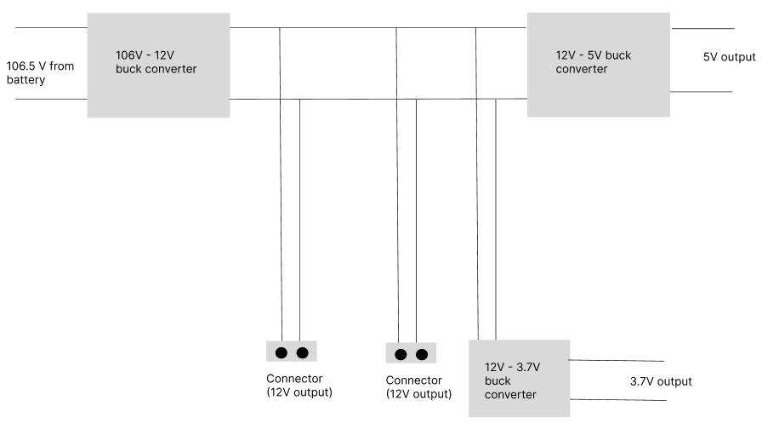
2.POWER PORTS PROGRESS
We completed research on the DC-DC converters and we were able to come up with a design on how we would accomplish this and it is as follows:

Slide 9
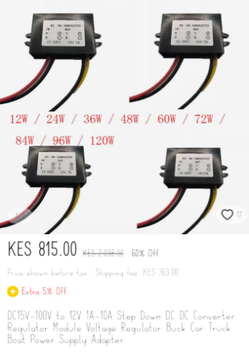
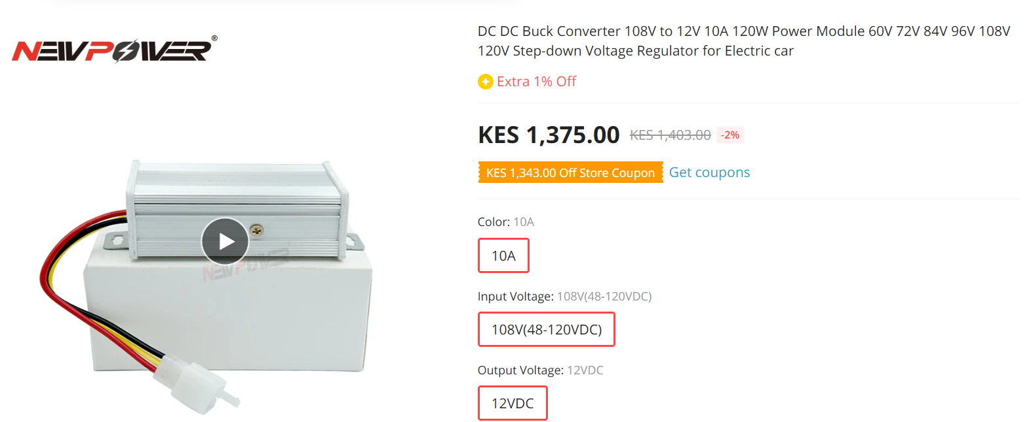
We have come across a few models of the buck converters and we are still looking for the best prices and suitability to come up with the bill of materials.
Here are some of them:

Slide 10
CONCLUSION
Time is running out and we are a long way to go to complete the project. However , we have talked to Dr.Aoki and he has suggested we parallel follow these three options:
Purchase a compatible foot pedal throttle.
Use local engineers to try and further troubleshoot the controller.
Research & see purchasing a popular, well-documented controller.

Slide 11
THANKS

